Slide 1
Android Application Development (I)
Practice – Project Breakdown (Storage)

Slide 2
Agenda
Self Introduction
Intellectual Property Rights
Project Introduction
Android Introduction
Get Started with Android
Requirement
Object-Oriented Analysis and Design
Scrum
Project Breakdown
Acceptance Test Criteria
Publish Application
Notes:
Object-oriented analysis and design (OOAD) is a software engineering approach that models a system as a group of interacting objects. Each object represents some entity of interest in the system being modeled, and is characterised by its class, its state (data elements), and its behavior. Various models can be created to show the static structure, dynamic behavior, and run-time deployment of these collaborating objects. There are a number of different notations for representing these models, such as the Unified Modeling Language (UML).
Object-oriented analysis (OOA) applies object-modeling techniques to analyze the functional requirements for a system. Object-oriented design (OOD) elaborates the analysis models to produce implementation specifications. OOA focuses on what the system does, OOD on how the system does it.
Ref: http://en.wikipedia.org/wiki/Object-oriented_analysis_and_design
IFRS - International Financial Reporting Standards
GAAP - Generally Accepted Accounting Principles

Slide 3
Data Storage Overview
Shared Preferences
Store private primitive data in key-value pairs.
Internal Storage
Store private data on the device memory.
External Storage
Store public data on the shared external storage.
SQLite Databases
Store structured data in a private database.
Network Connection
Data Backup

Slide 4
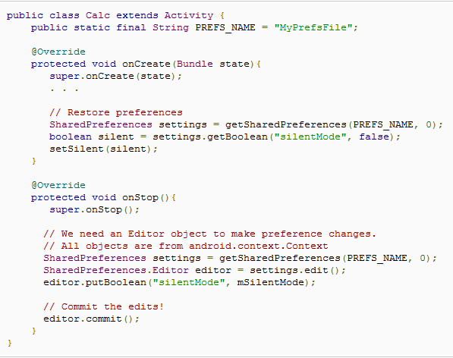
Data Storage Shared Preferences
Provides a general framework that allows you to save and retrieve persistent key-value pairs of primitive data types (booleans, floats, ints, longs, and strings).
Get preferences
Get primitive data
Edit primitive data
Save primitive data
Commit

Slide 5
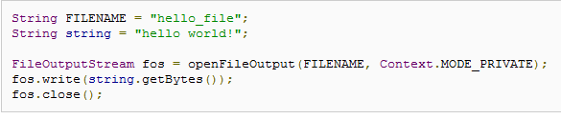
Data Storage Internal Storage
Save files directly on the device's internal storage
Typical Usage:
Save a static file in your project res/raw/ directory.
Open it with openRawResource(), passing the R.raw.<filename> resource ID.
Use the returned InputStream read the file (but can NOT write to the original file)
Private to your application

Slide 6
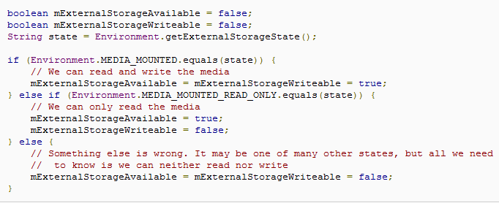
Data Storage External Storage
Android-compatible device supports a shared "external storage" to save files
Removable Storage Media (SD card)
Internal non-removable Storage (eMMC)
Check whether the media is available
getExternalFilesDir() to open a file
getExternalStoragePublicDirectory() to save file so as to Not be deleted when app is uninstalled

Slide 7
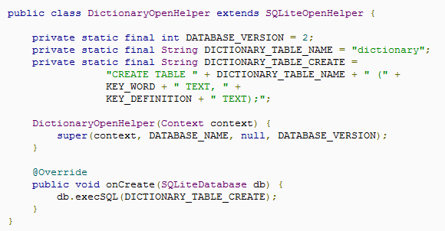
Data Storage SQLite Databases
Any databases you create will be accessible by name to any class in the application, but NOT outside the application.
Create/Open database
SQLiteDatabase.getWritableDatabase()
SQLiteDatabase.getReadableDatabase()
Query
SQLiteDatabase.query()
 | Column1 | Colunm2
Row1 | R1C1 | R1C2
Row2 | R2C1 | R2C2
Cursor

Slide 8
Data Storage Data Backup
Android's backup service allows you to copy your persistent application data to remote "cloud" storage, in order to provide a restore point for the application data and settings.
Device
Cloud
/Music
Backup Manager
Backup
/Pictures
Repository
Restore
/Movies
……

Slide 9
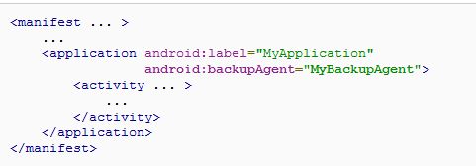
Data Storage Data Backup Cont.
Declaring the Backup Agent in Your Manifest
android:restoreAnyVersion to indicate whether you want to restore the application data regardless of the current application version compared to the version that produced the backup data

Slide 10
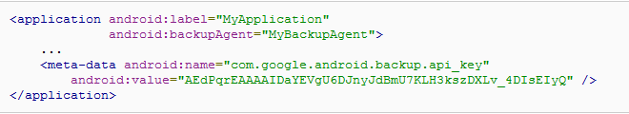
Data Storage Data Backup Cont.
Registering for Android Backup Service
http://code.google.com/android/backup/signup.html
Do NOT change to other
Use the key you received while registering

Slide 11
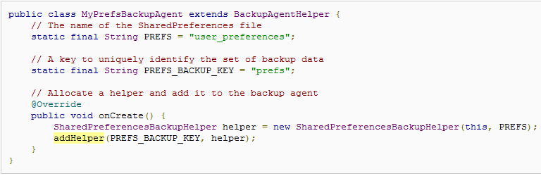
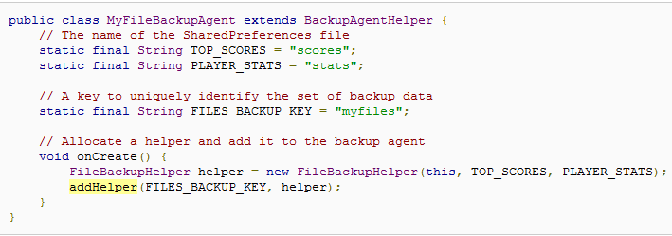
Data Storage Data Backup Cont.
Easy to be used compared ot
BackupAgent
Extending BackupAgentHelper to backup complete files
Backing up SharedPreferences
Backing up other files from internal storage
SharedPreferences are thread-safe
reading and writing to files on internal storage is are NOT thread-safe

Slide 12
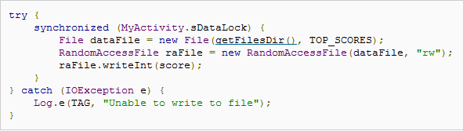
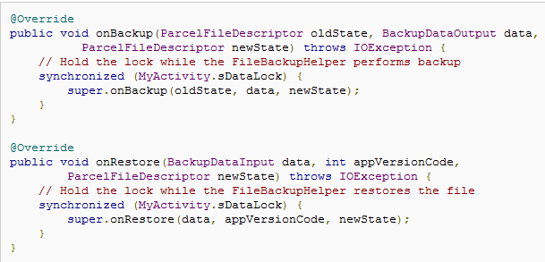
Data Storage Data Backup Cont.
Use synchronized statements each time you perform a read or write to ensure that your backup agent does not read or write your files at the same time as your activities
In the activity, an object to use as the intrinsic lock for the synchronized statements is needed
Thread-safe
Create a synchronized statement with this lock to read/write file
Override onBackup() and onRestore()
to synchronize the backup and restore operations with the same intrinsic lock

Slide 13
Contend Provider Overview
Provides the way to expose even your private data to other applications
Manage access to a structured set of data
Standard interface that connects data in one process with code running in another process (IPC)
Tip: You don't need to develop your own provider if you don't intend to share your data with other applications

Slide 14
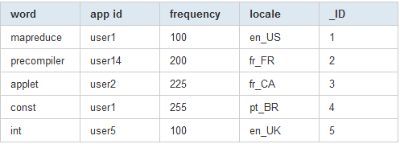
Content Provider Overview - Table
Primary Key

Slide 15
Content Provider Overview - Accessing A Provider
The ContentResolver methods provide the basic "CRUD" (create, retrieve, update, and delete) functions of persistent storage
ContentResolver Object
ContentProvider
Object
Client
Server

Slide 16
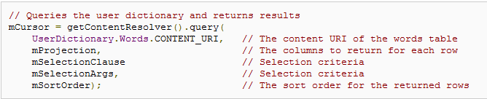
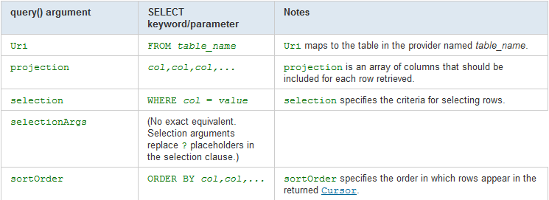
Content Provider Overview - Accessing A Provider Cont.

Slide 17

Content Provider Overview - Content URIs
A content URI is a URI that identifies data in a provider.
The symbolic name of the entire provider (its authority)
The name that points to a table (a path)
Provider’s Authority
Table’s path

Slide 18
Content Provider Retrieving Data from the Provider
Request the access permission for the provider
Explicitly claim the element: <uses-permission> in AndroidManifest
Data access via intents
Getting access with temporary permissions
Using another application
Like: the Calendar application accepts an ACTION_INSERT intent, which allows you to activate the application's insert UI
Activity without Permission
startActivityForResult() with intent ACTION_PICK
onActivityResult() to receives the result intent created and get the data from that provider
Activity with Permission
setResult() with FLAG_GRANT_READ_URI_PERMISSION

Slide 19
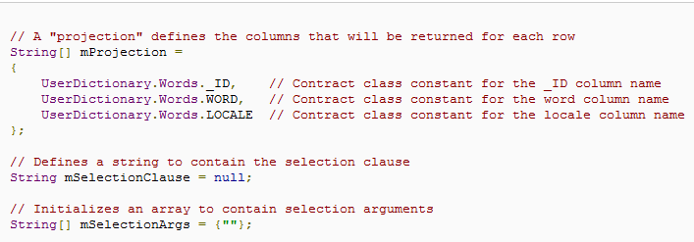
Content Provider Retrieving Data from the Provider
Define the code that sends a query to the provider
Constructing the query

Slide 20
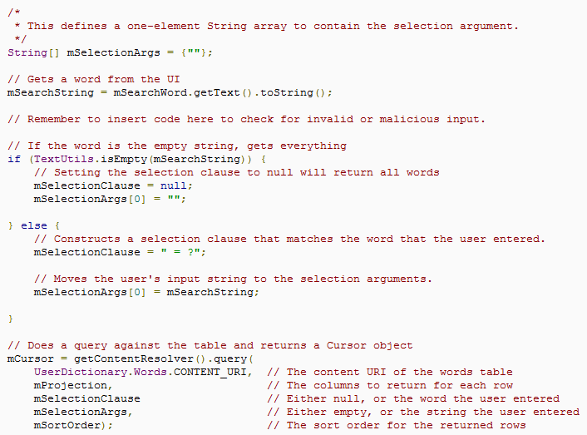
Content Provider Retrieving Data from the Provider
Define the code that sends a query to the provider Cont.
Query execution

Slide 21
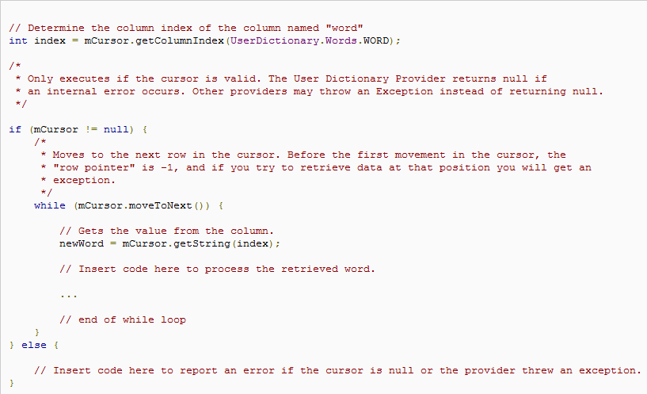
Content Provider Retrieving Data from the Provider
Define the code that sends a query to the provider Cont.
Getting data from query result by cursor

Slide 22
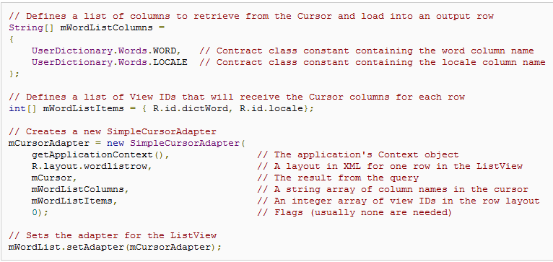
Content Provider Retrieving Data from the Provider
Define the code that sends a query to the provider Cont.
Displaying query results with SimpleCursorAdapter on ListView

Slide 23
Project Breakdown (SoundRecorder) Requirement - Start/Pause/Stop Playing
Basic Requirement (Mandatory)
Implement the list to display all items of recorded audio files
Implement the callback for button start/stop to play audio
Implement the callback for button to delete the selected item
Update playing time timely in text view
Advanced Requirement (Optional)
Implement the callback for button to show detailed information (file name, file type, duration, file size, date created and file path) of audio content
Update progress bar timely according to the progress of audio file while playing in customized view
Share the audio file with MMS, Gmail, etc by long press list item
Set audio as phone ringtone, notification ringtone, alarm ringtone

Slide 24
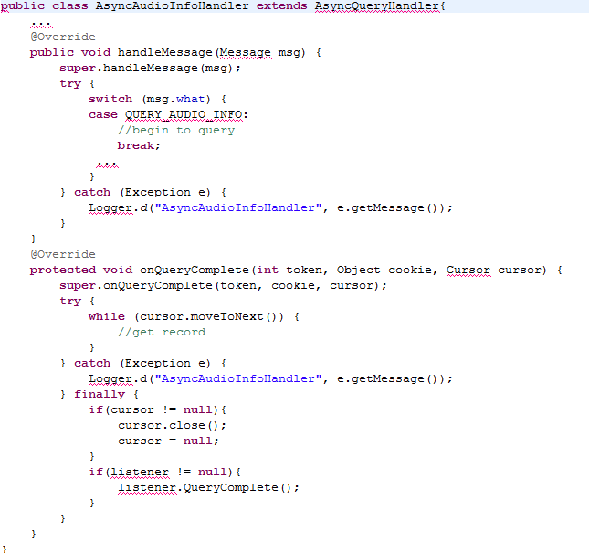
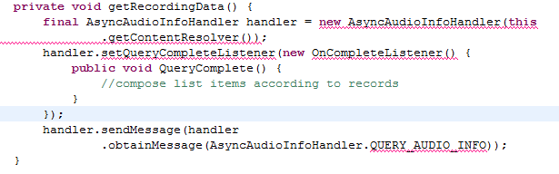

Project Breakdown (SoundRecorder) Hints – AsyncQueryHandler (Asynchronous Query)
A helper class to help make handling asynchronous ContentResolver queries easier [Ref]
Begin to query
Compose list item
2
4
1
3
Design the interface
Get records

Slide 25
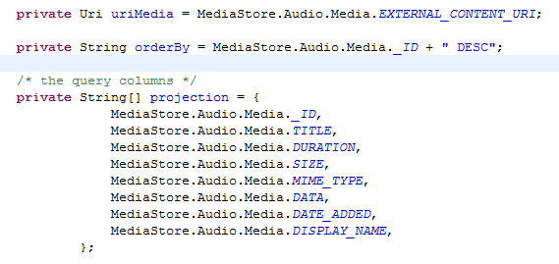
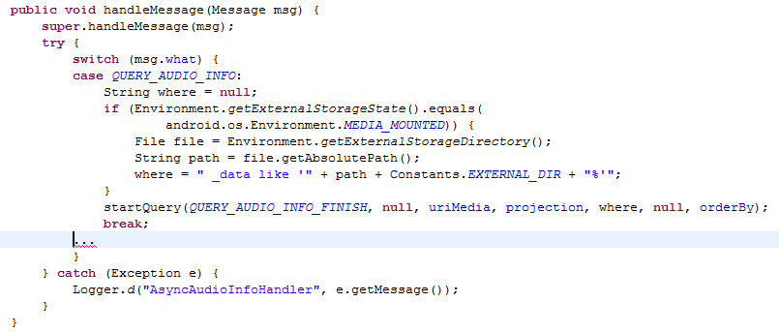
Project Breakdown (SoundRecorder) Hints – AsyncQueryHandler (startQuery)
This method begins an asynchronous query. When the query is done onQueryComplete(int, Object, Cursor) is called [Ref]
Project
Selection

Slide 26
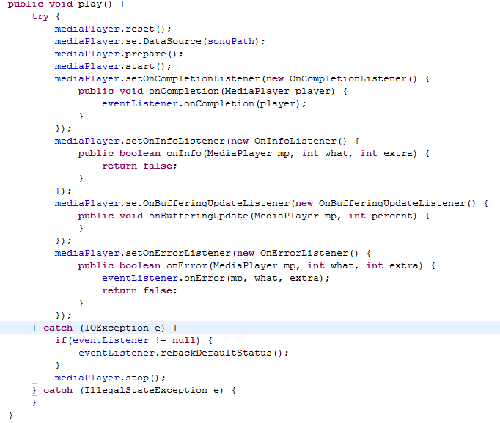
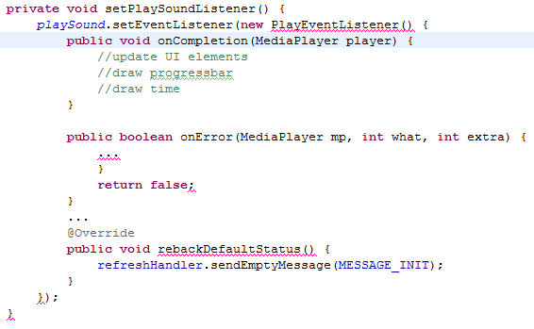
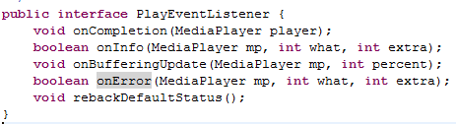
Project Breakdown (SoundRecorder) Hints – MediaPlayer (Start/Pause/Stop)
MediaPlayer class can be used to control playback of audio/video files and streams [Ref]
2
3
1
Note: Design a class to encapsulate all operations of MediaPlayer to ease coding

Slide 27
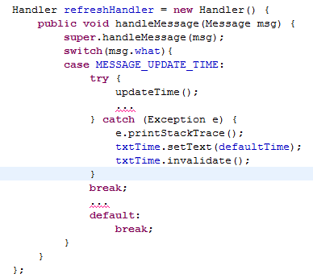
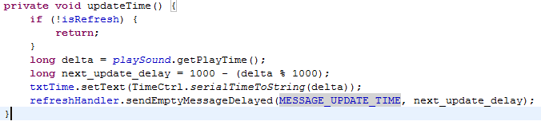
Project Breakdown (SoundRecorder) Hints – Handler (Continuously Update Time While Playing)
A Handler allows you to send and process Message and Runnable objects associated with a thread's MessageQueue. Each Handler instance is associated with a single thread and that thread's message queue. When you create a new Handler, it is bound to the thread / message queue of the thread that is creating it -- from that point on, it will deliver messages and runnables to that message queue and execute them as they come out of the message queue. [Ref]
Continuously update time

